Slide 1
CD2 Presidential Primary Training
Heritage Library in Lakeville
Tuesday, January 16th at 5:45 PM

Slide 2
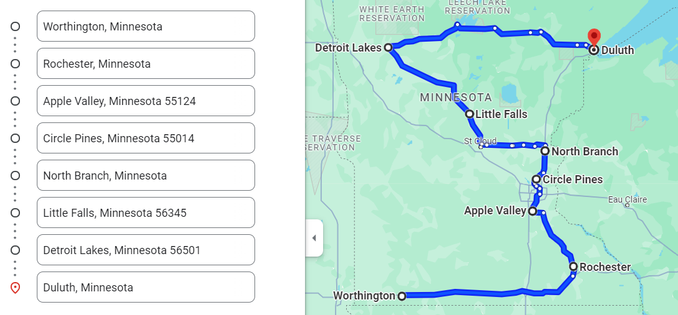

Slide 3
Thursday, 1/11 at the CENTENNIAL LIBRARY
7:00 PM - 9:00 PM | 100 Civic Heights Circle Circle Pines, MN 55014
Friday, 1/12 at the LITTLE FALLS CARE CENTER
6:30 PM - 8:30 PM | 1200 1st Avenue NE Little Falls, MN 56345 **location change
Saturday, 1/13 at the NOBLES COUNTY HISTORICAL SOCIETY
9:00 AM - 11:00 AM | 225 9th Street Worthington, MN 56187
Saturday, 1/13 at the ROCHESTER PUBLIC LIBRARY
2:30 PM - 4:30 PM | 101 2nd Street SE Rochester, MN 55904
Sunday, 1/14 at the DULUTH COMFORT WEST INN
2 PM - 4 PM | 3900 W. Superior Street Duluth, MN 55807
Sunday, 1/14 at the NORTH BRANCH AMERICAN LEGION
7:00 - 9:00 PM | 6439 Elm Street North Branch, MN 55056
Monday, 1/15 at the HISTORIC HOLMES THEATER
6:45 PM - 8:45 PM | "Holmes Art Cellar" 806 Summit Avenue Detroit Lakes, MN 56501
Tuesday, 1/16 at the LAKEVILLE LIBRARY
﻿5:45 PM - 8:00 PM | 20085 Heritage Drive Lakeville, MN 55044

Slide 4
2020 Presidential Primary
vs.
2024 Presidential Primary
vs.
Caucuses

Slide 5
Agenda
Why is Minnesota’s data so unique?
Historic presidential caucus & primary turnout
Our timeline
Advantage
Unidentified voters
Absentee ballots
SwipeRed
Texting
Calling
Caucus turnout
Questions

Slide 6
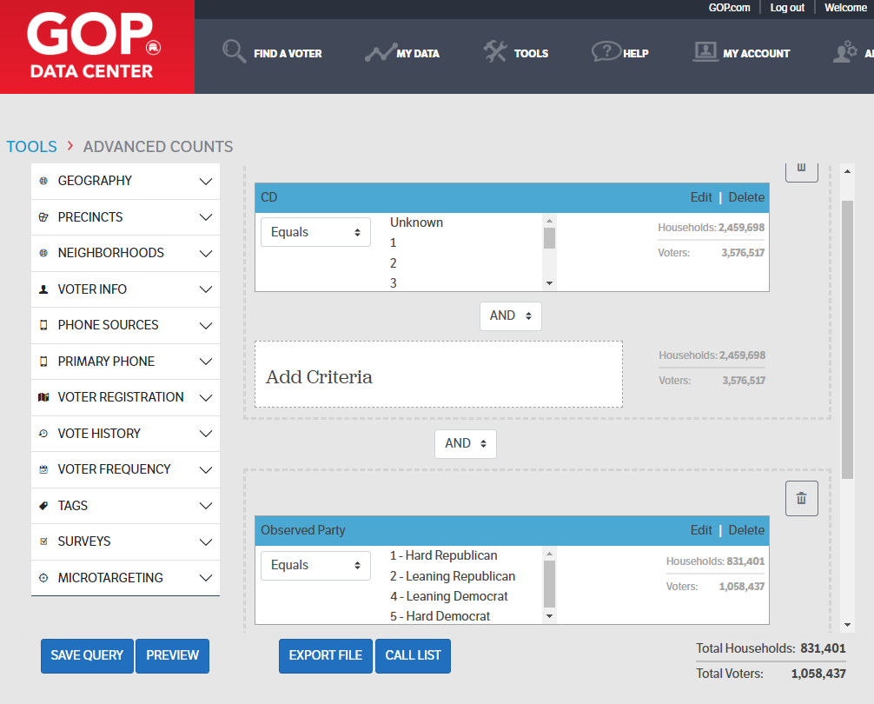
“Labels” for Voters:
Observed
Calculated
Official
“Known” MN Voters:
Hard R: 349,236
Lean R: 264,346
Lean D: 210,969
Hard D: 233,886
1,058,437 = 29.59%

Slide 7
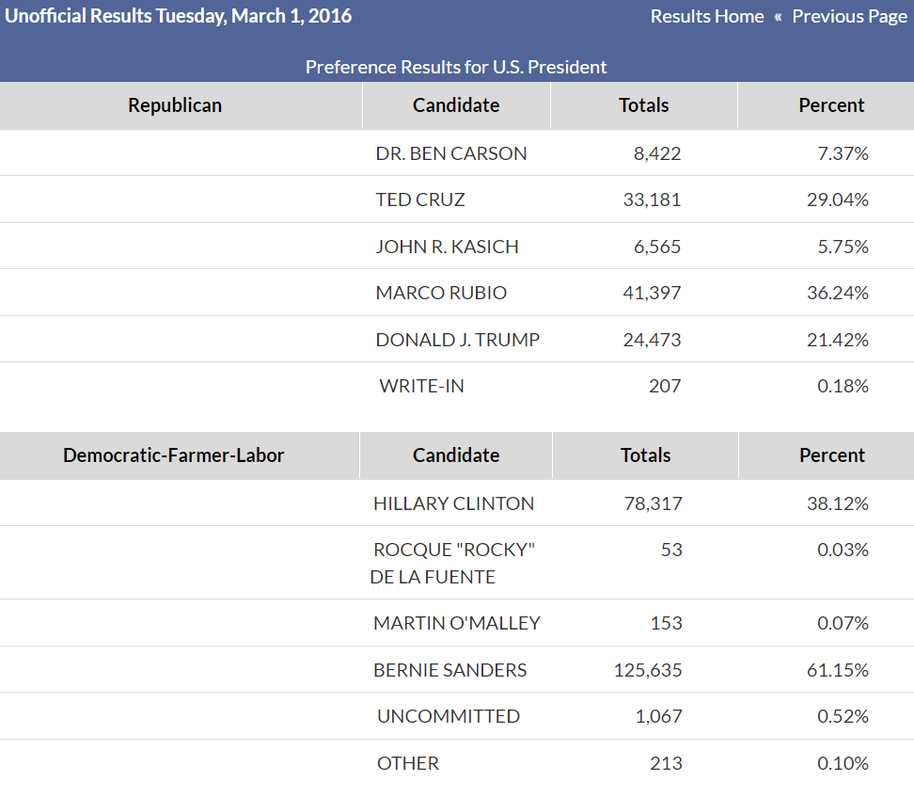
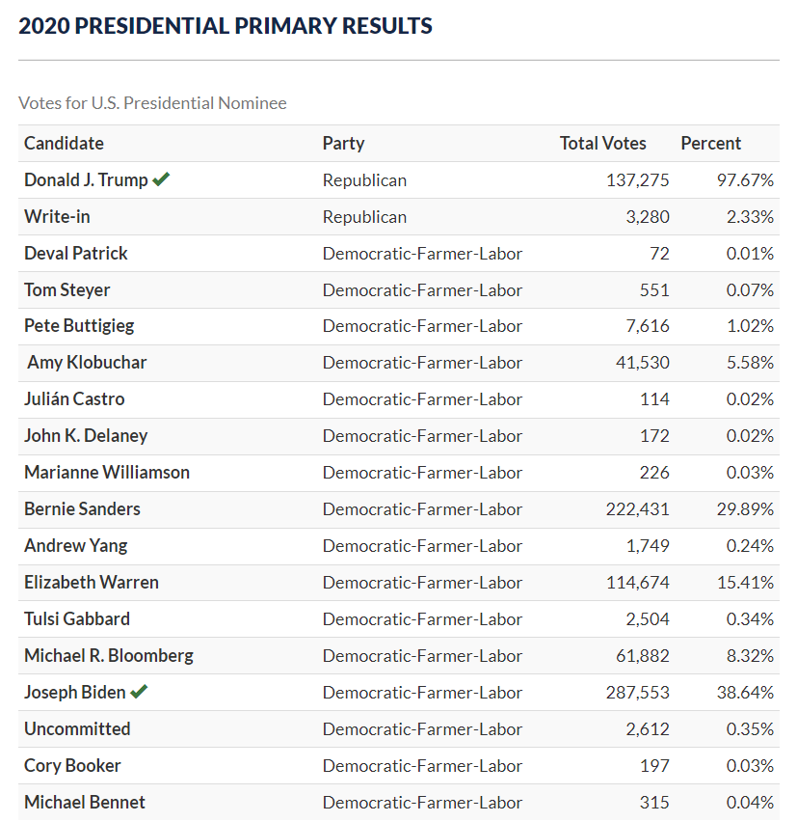
205,437 Democrats 744,198 Democrats
114, 245 Republicans 140,555 Republicans

Slide 8
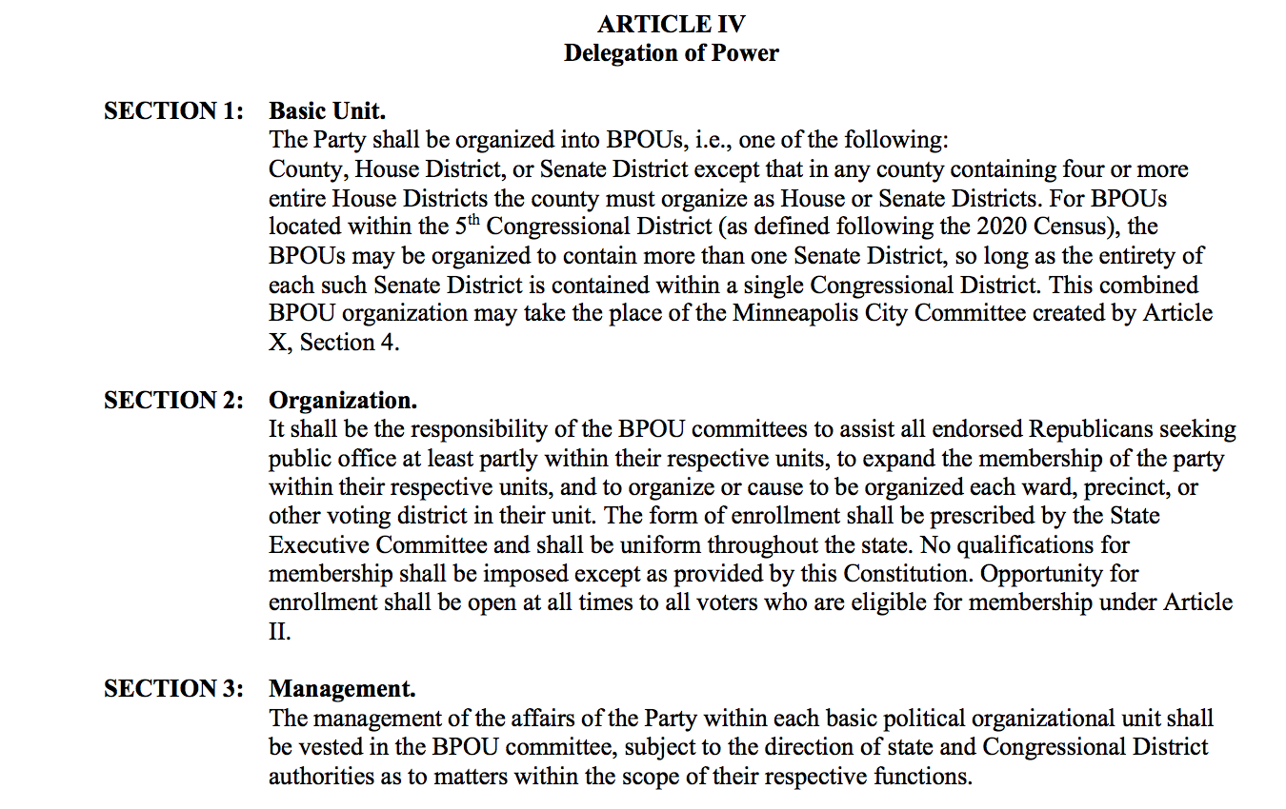

Slide 9
SECTION 2: Organization. It shall be the responsibility of the BPOU committees to ASSIST all endorsed Republicans seeking public office at least partly within their respective units, to EXPAND the membership of the party within their respective units, and to
ORGANIZE each ward, precinct, or other voting district in their unit. The form of enrollment shall be prescribed by the State Executive Committee and shall be uniform throughout the state. No qualifications for membership shall be imposed except as provided by this Constitution. Opportunity for enrollment shall be open at all times to all voters who are eligible for membership under Article II.

Slide 10
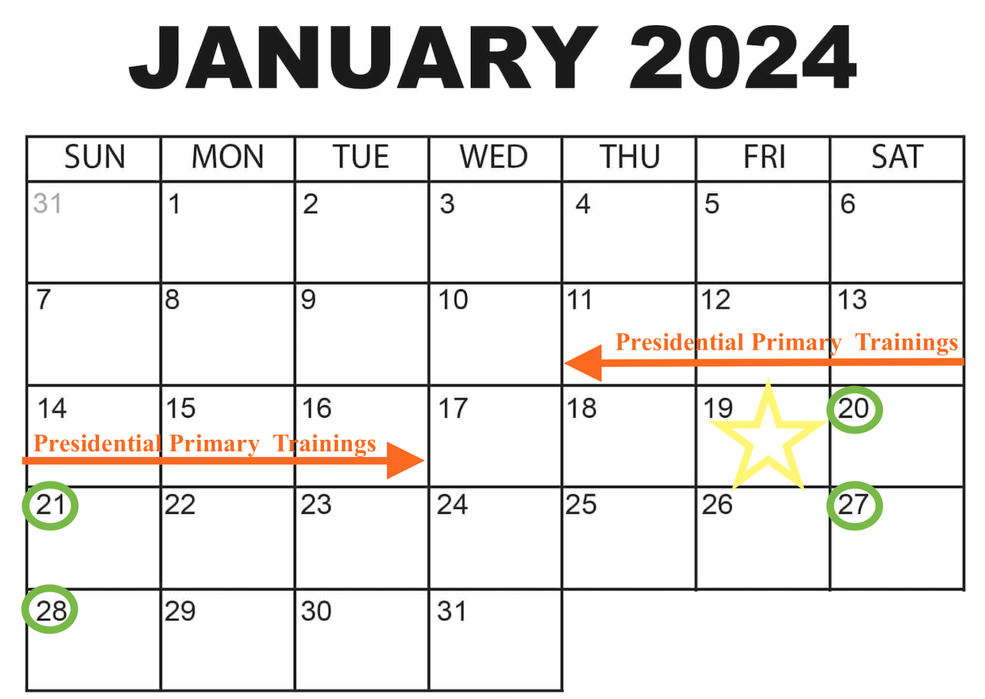
January 19 - early voting starts
Ballots mailed 60 days prior to 3/5

Slide 11
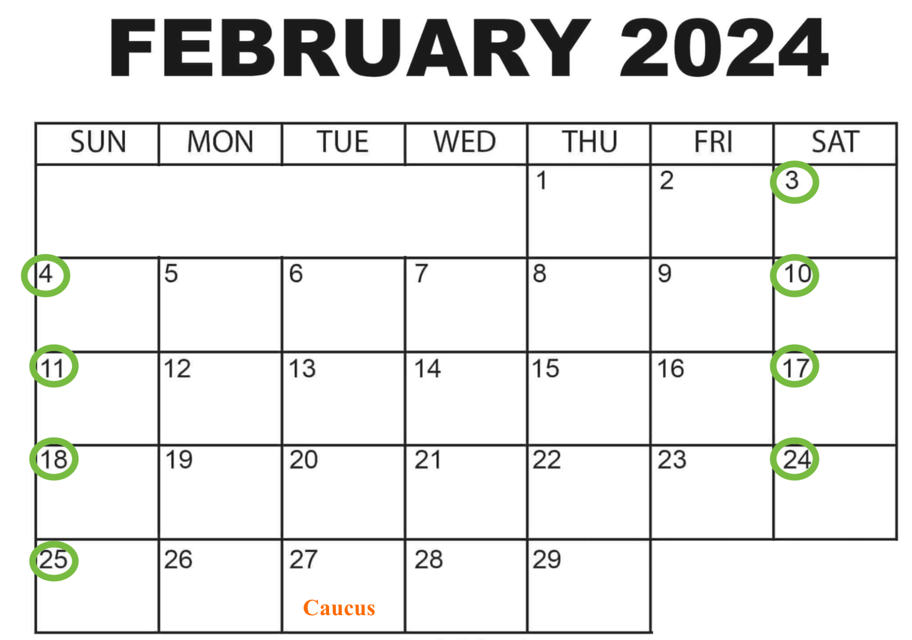

Slide 12
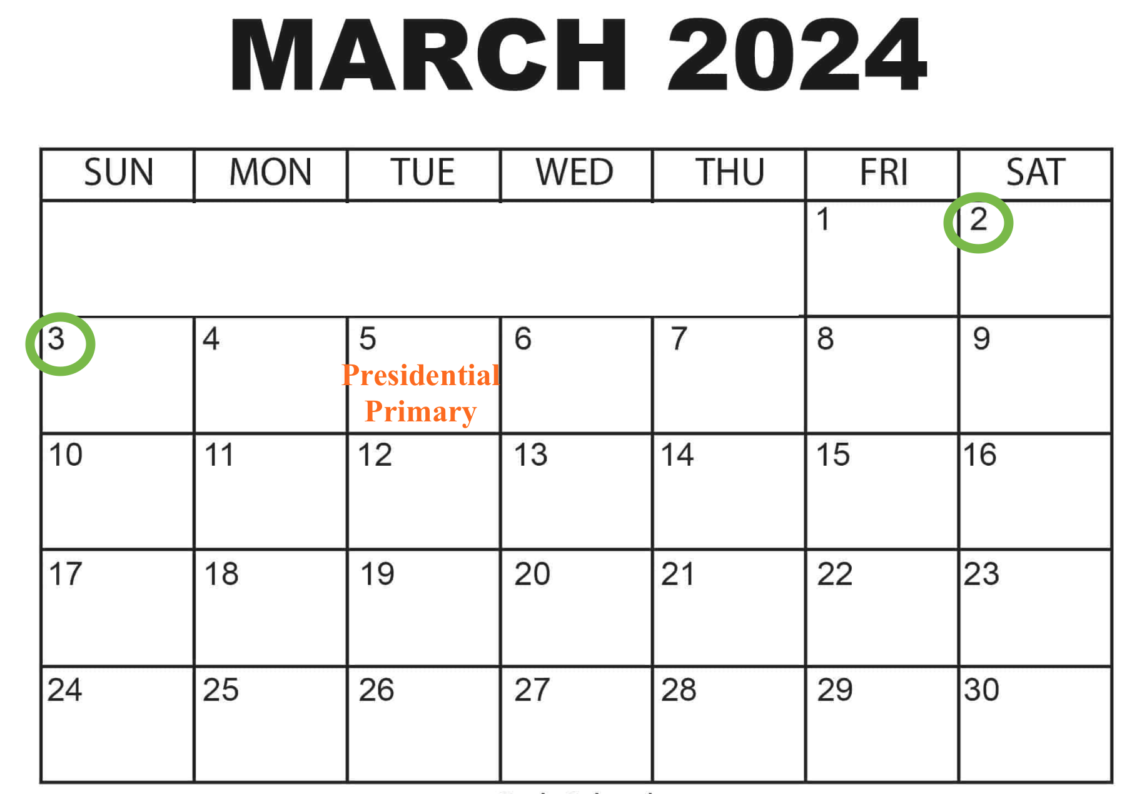
< 3 months
7 weekends
14 days

Slide 13
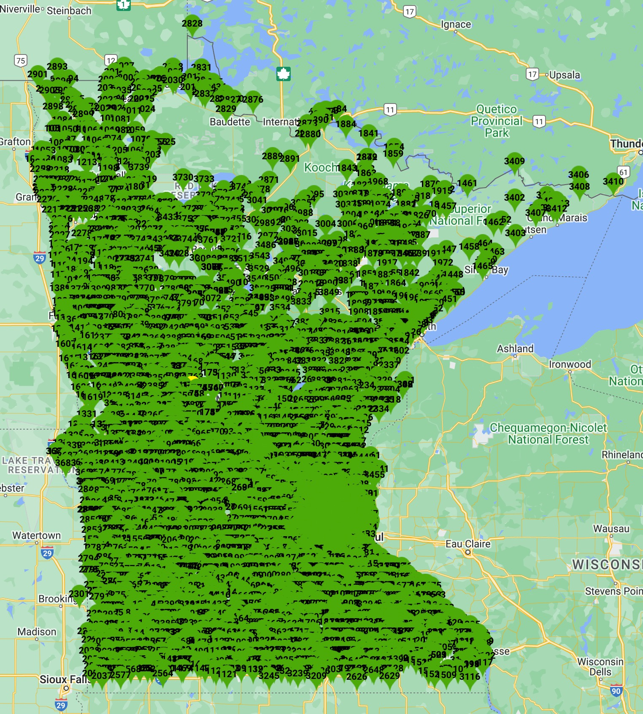
Advantage
120+ BPOUs
87 counties
1.3 million unidentified (swing/independent) voters = 10K per BPOU
Usernames:
HD66B#
MurrayCo#
SD40BPOU#
Becker#
Each BPOU board will receive a group email with your BPOU’s specific usernames and passwords.

Slide 14
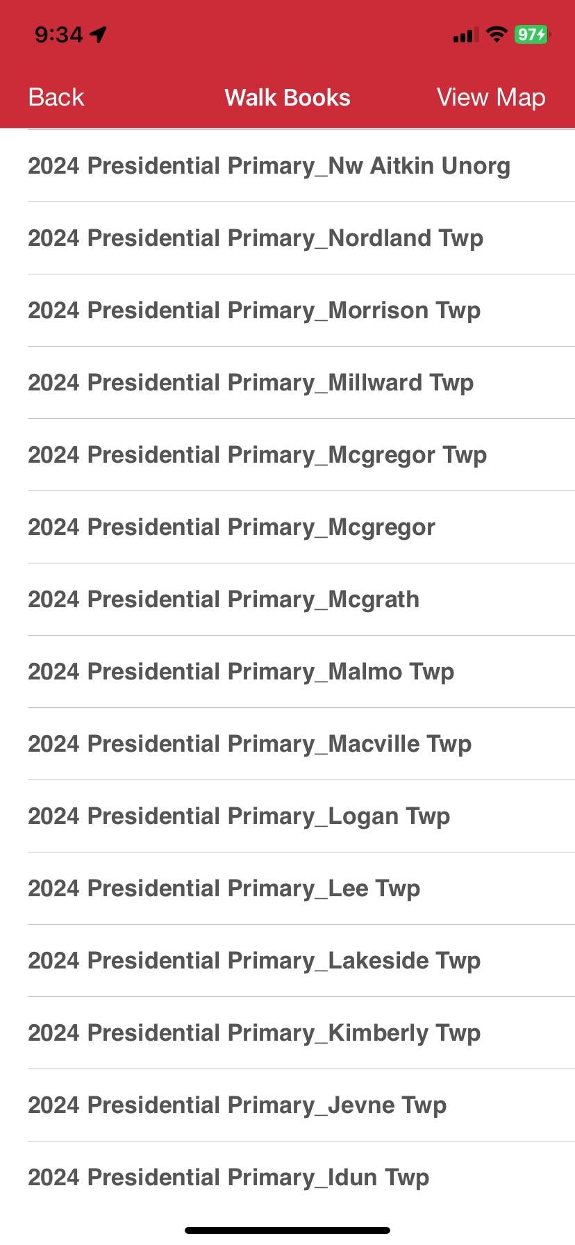
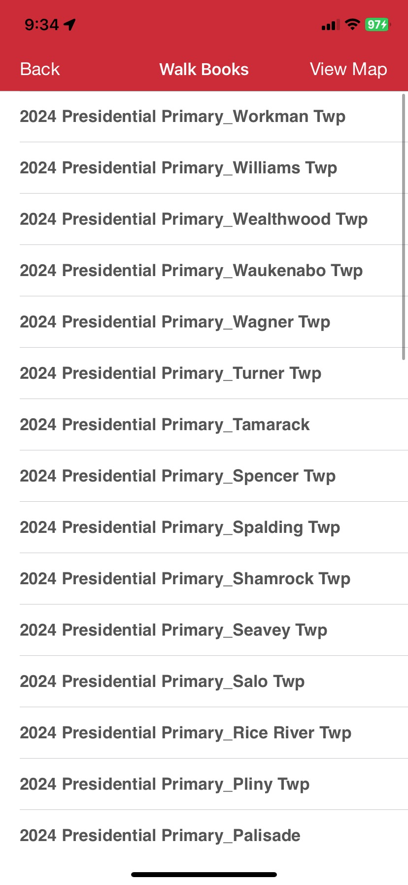
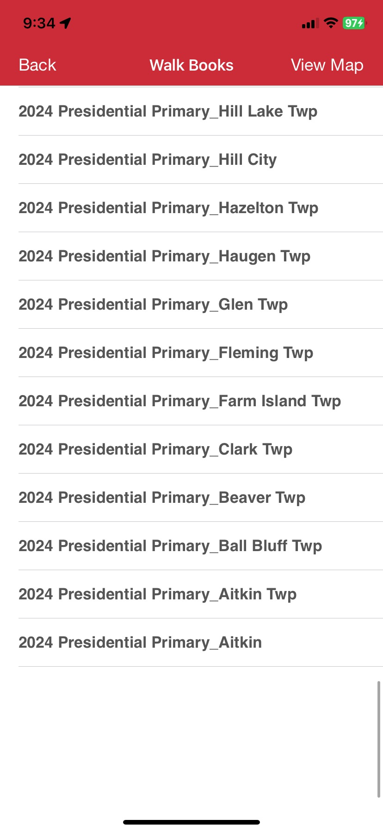
Advantage - Walkbooks
-ex: Aitkin County
-split by precinct
-some HDs/SDs inside of counties

Slide 15
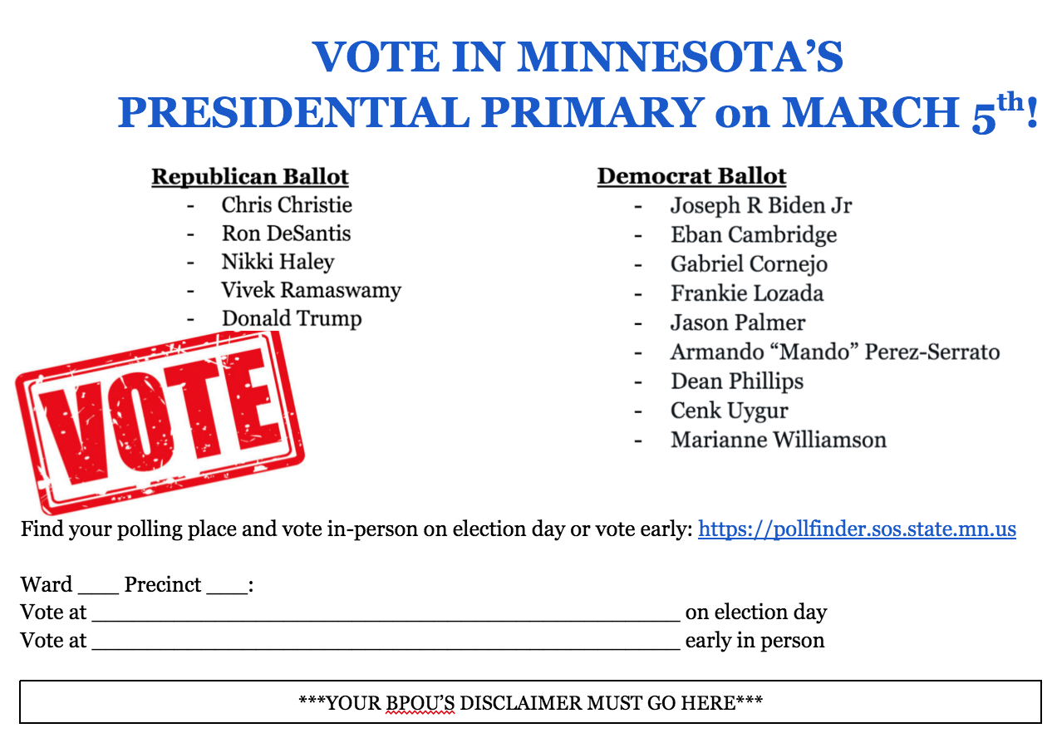
Sample handout for door knocking (posted as a .docx on the website)

Slide 16
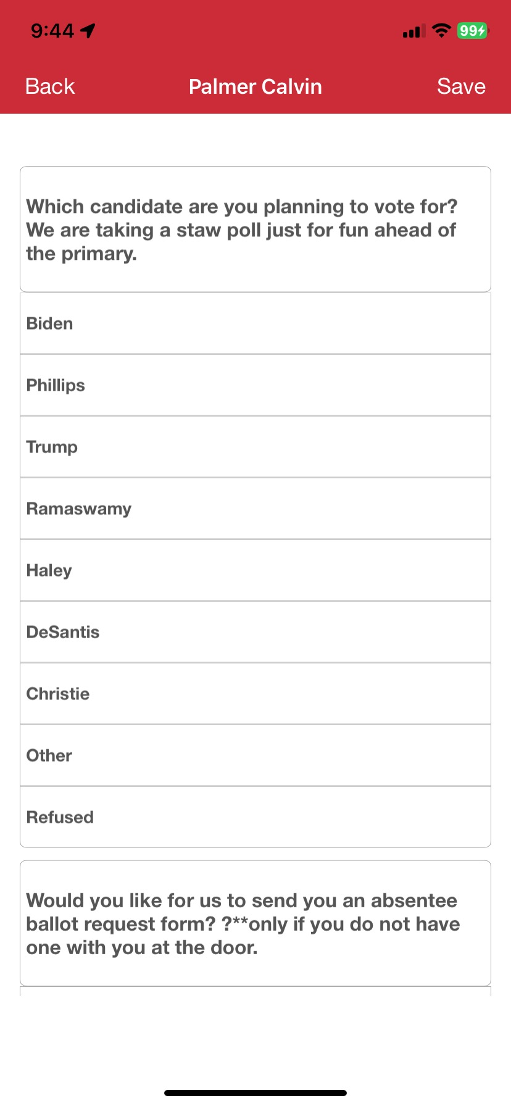
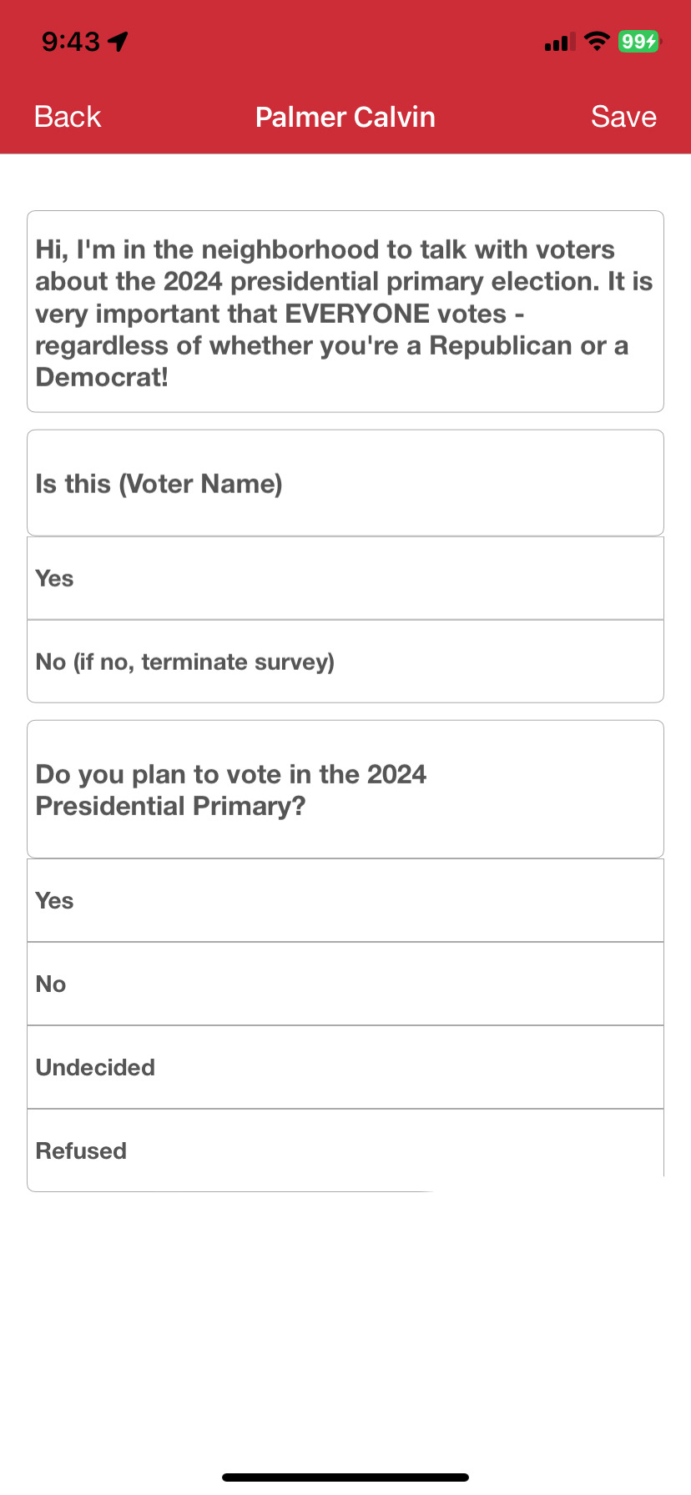
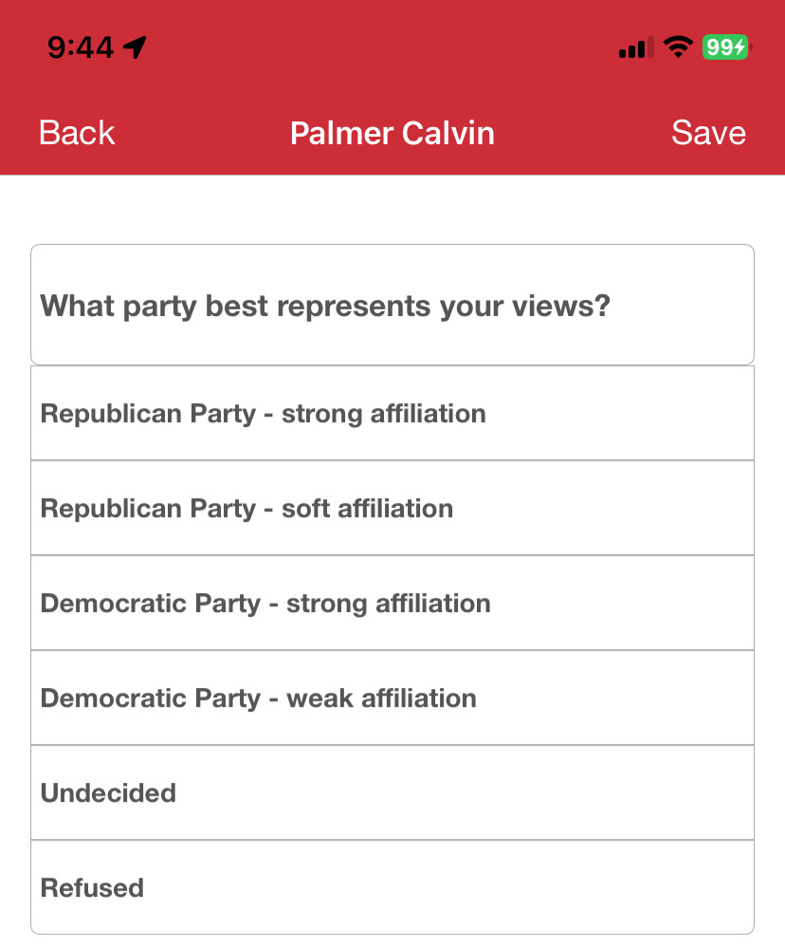
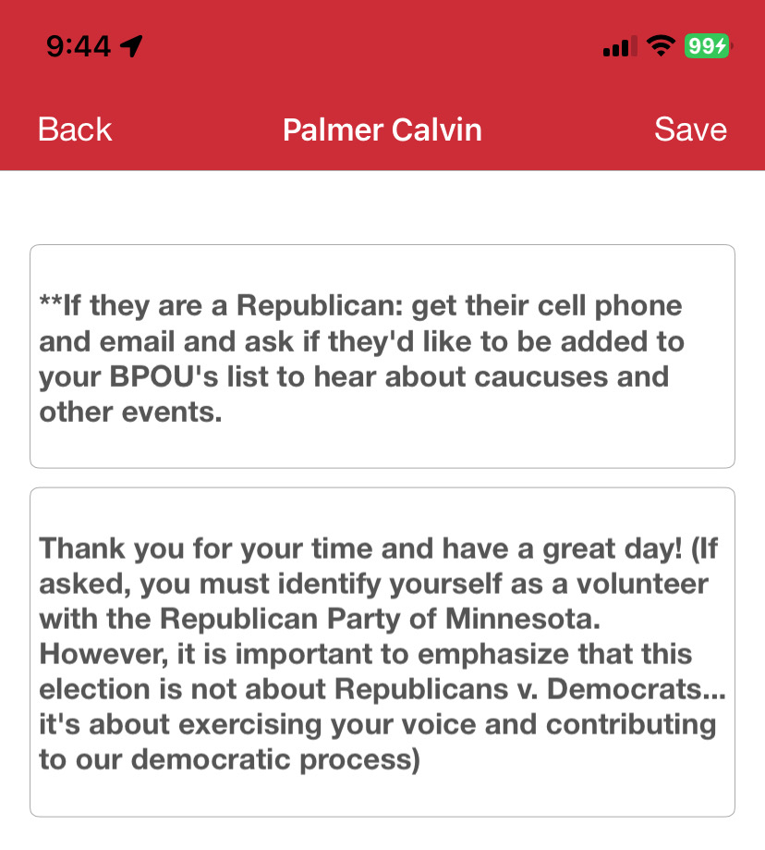
Advantage - Survey

Slide 17
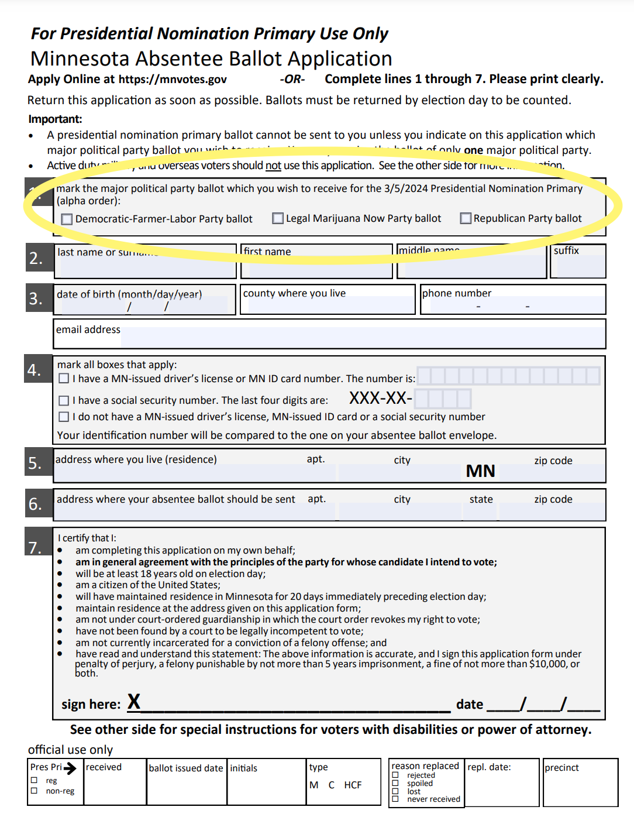
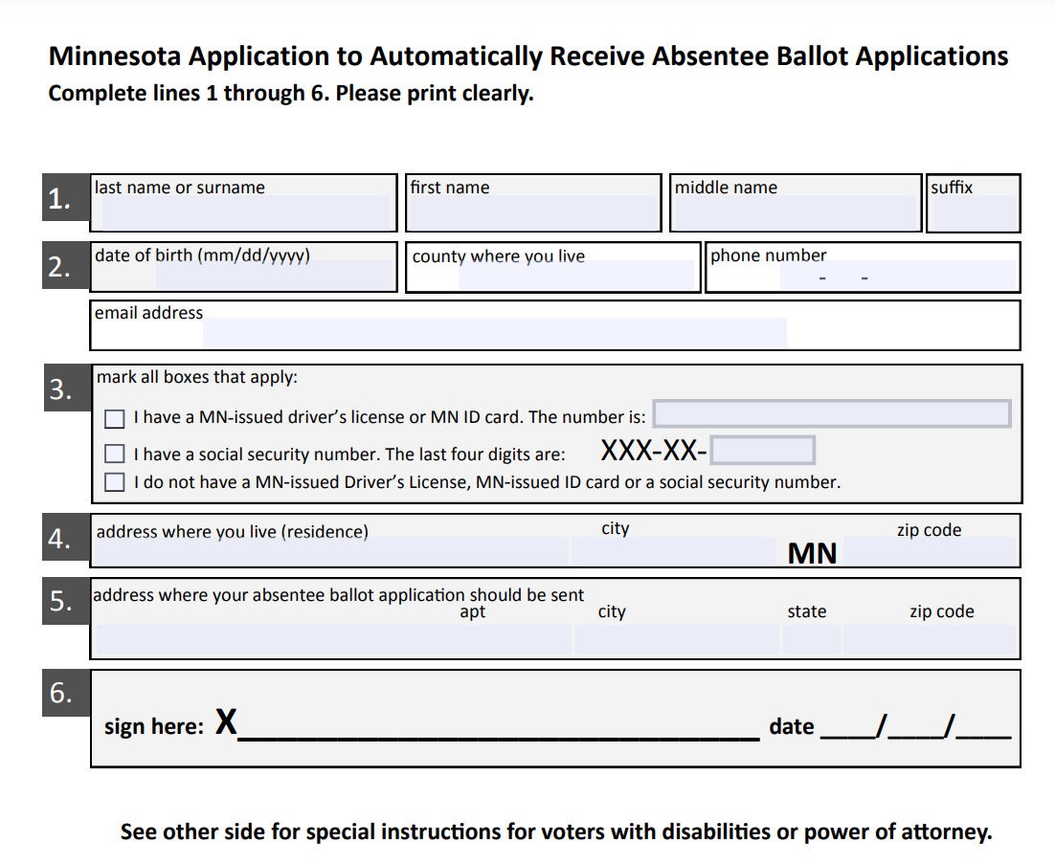

Slide 18
Absentee Ballots
If someone asks for an absentee request, you legally *MUST* give them one
All absentee requests (GOP and DFL) *MUST* be returned to the county election office as soon as possible: https://www.sos.state.mn.us/elections-voting/find-county-election-office/
Ballot return window
Disengaged voters & the automatic absentee ballot list
https://www.sos.state.mn.us/media/1914/application-to-automatically-receive-absentee-applications.pdf (automatic absentee ballot application)
www.sos.state.mn.us/media/3899/2024-presidential-primary-absentee-ballot-application.pdf (regular print)
www.sos.state.mn.us/media/2688/large-print-english-regular-absentee-ballot-application.pdf (large print)
www.sos.state.mn.us/elections-voting/how-elections-work/presidential-primary/ (general info)

Slide 19
Killing two birds with one stone
&
maximizing caucus turnout along the way

Slide 20
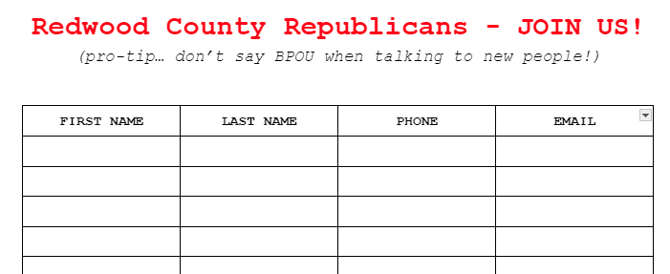
Ideas to include on a caucus handout FOR REPUBLICANS ONLY:
Email & phone number for BPOU
Upcoming BPOU events
Caucus locations for the whole BPOU
LInk to caucus finder website on SOS (will be available starting Feb. 7 at https://www.sos.state.mn.us/elections-voting/how-elections-work/precinct-caucuses/)
Results from 2022 elections to help convince people to VOTE!
Statewide auditor’s race: lost by 8,000 votes
Statewide attorney general’s race: lost by 20,000
Minnesota House: lost by less than 4,000 votes (less than 1,000 votes in 7 districts)
Minnesota Senate: lost by less than 300 votes

Slide 22
What is SwipeRed?
Your contacts
Texting
Calling
Social media
Your “smart matches”
Phone calling
Surveying voters which automatically updates data in Data Center
GOAL: collecting voter data as inexpensively as possible

Slide 25
Impact:
3,500 state convention delegates
x
700 contacts in your phone
= 2,450,000 contacts

Slide 27
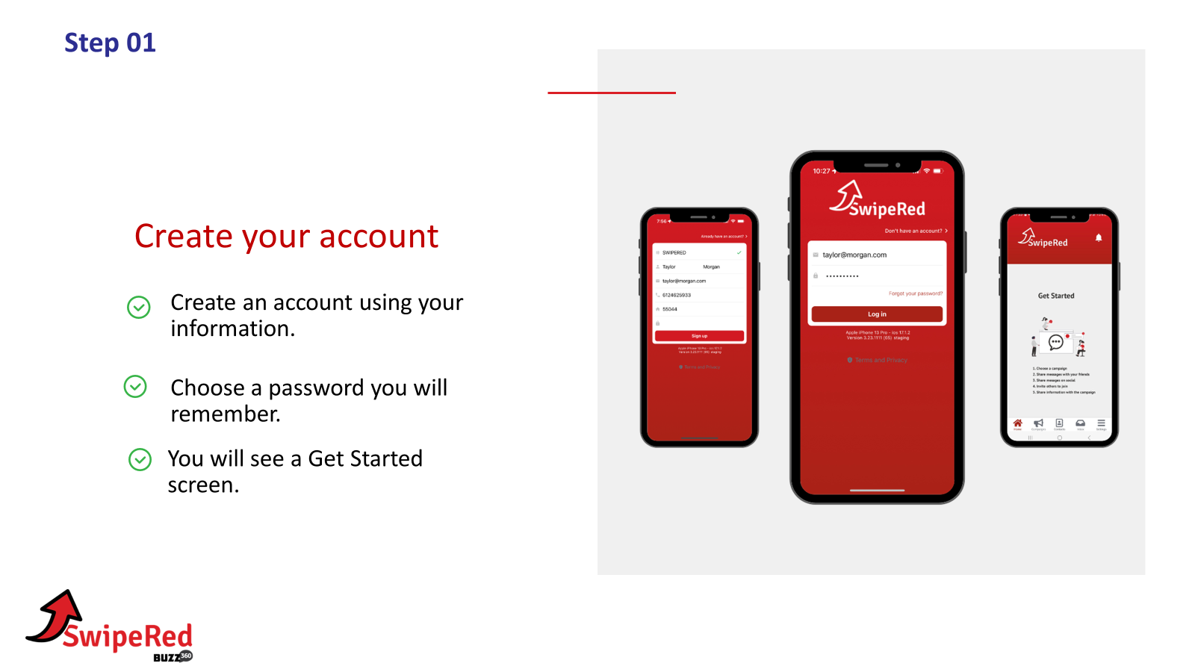
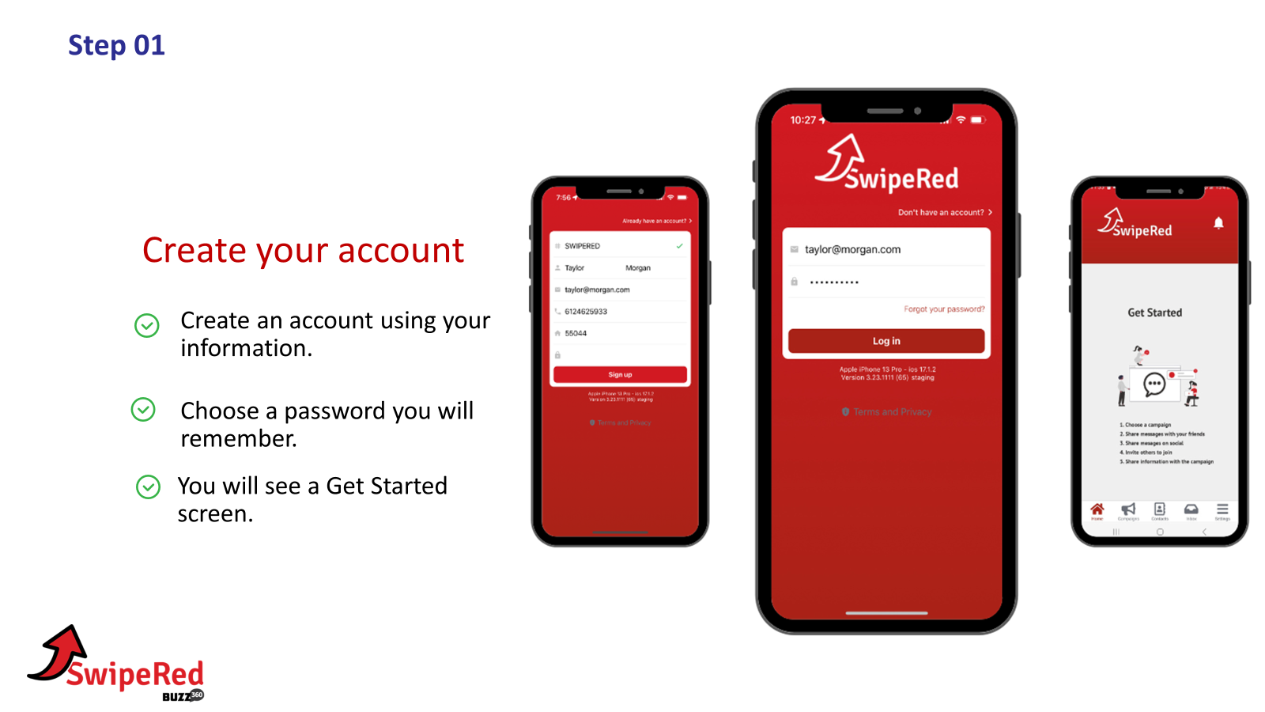

Slide 28
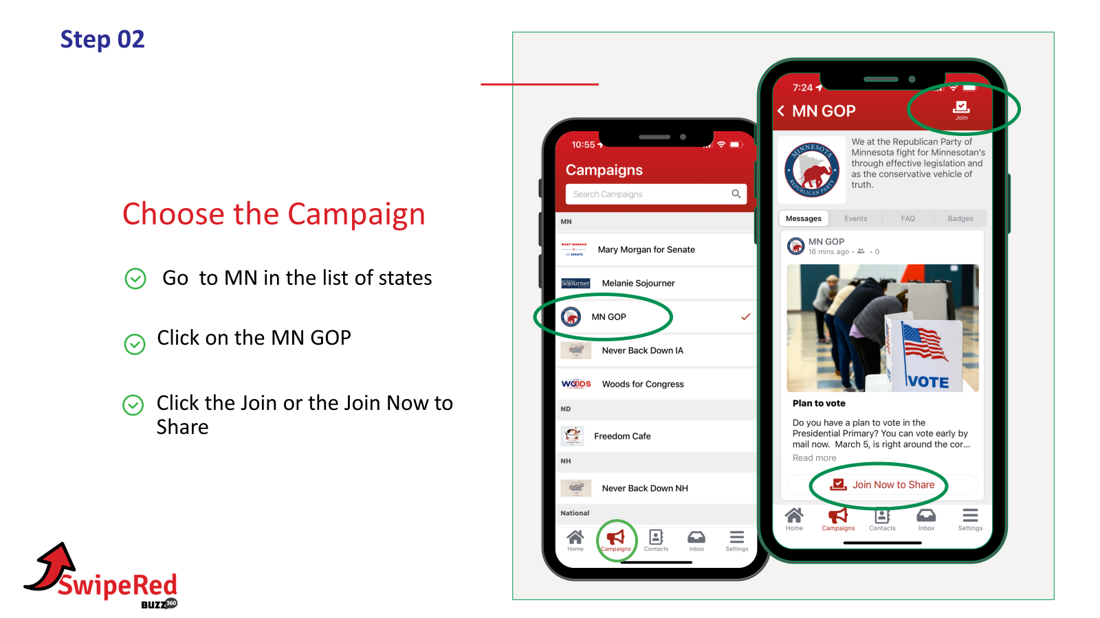
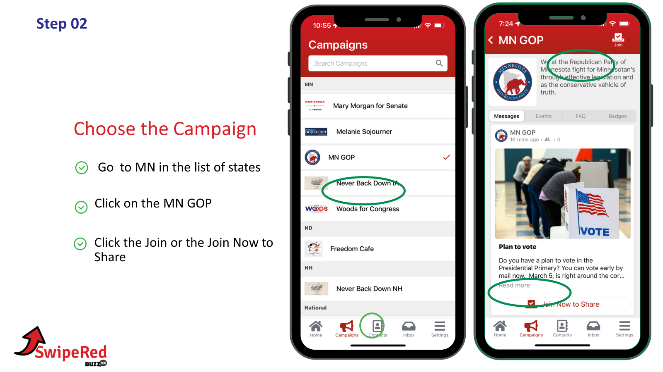
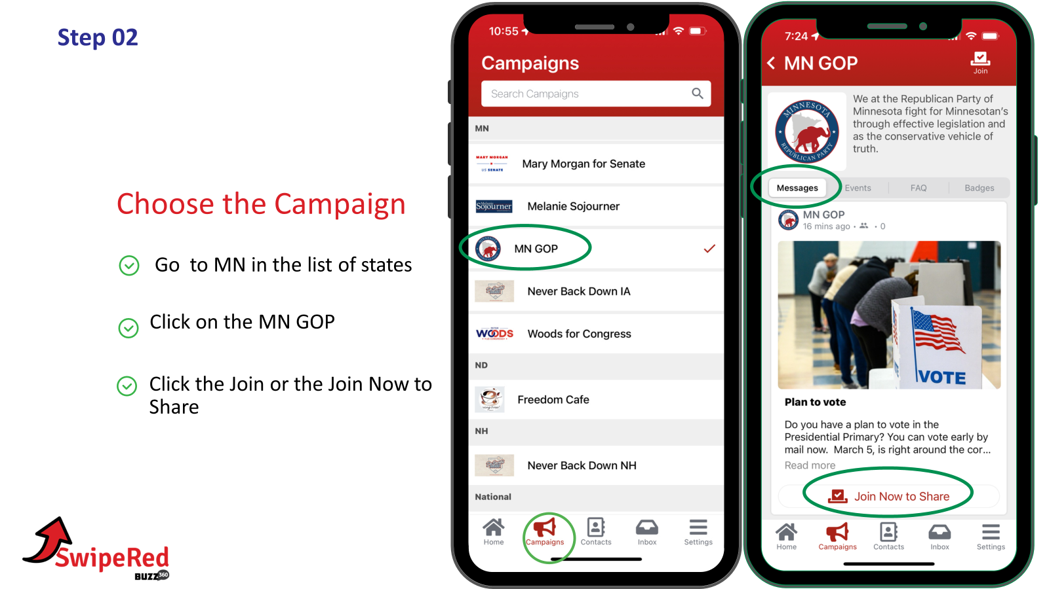

Slide 29
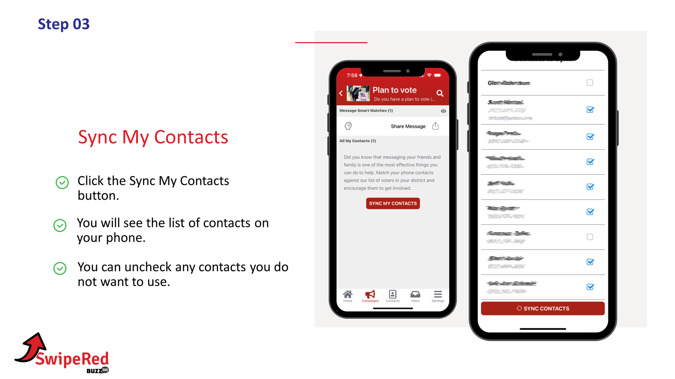
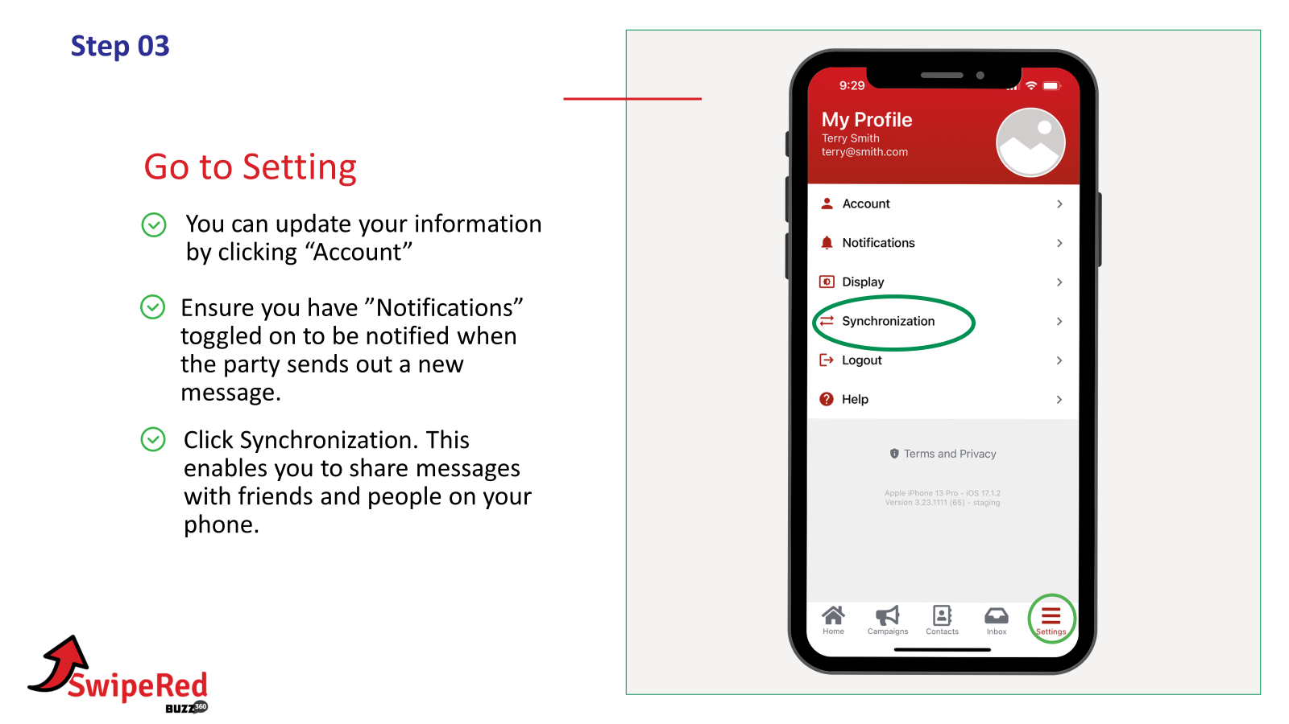
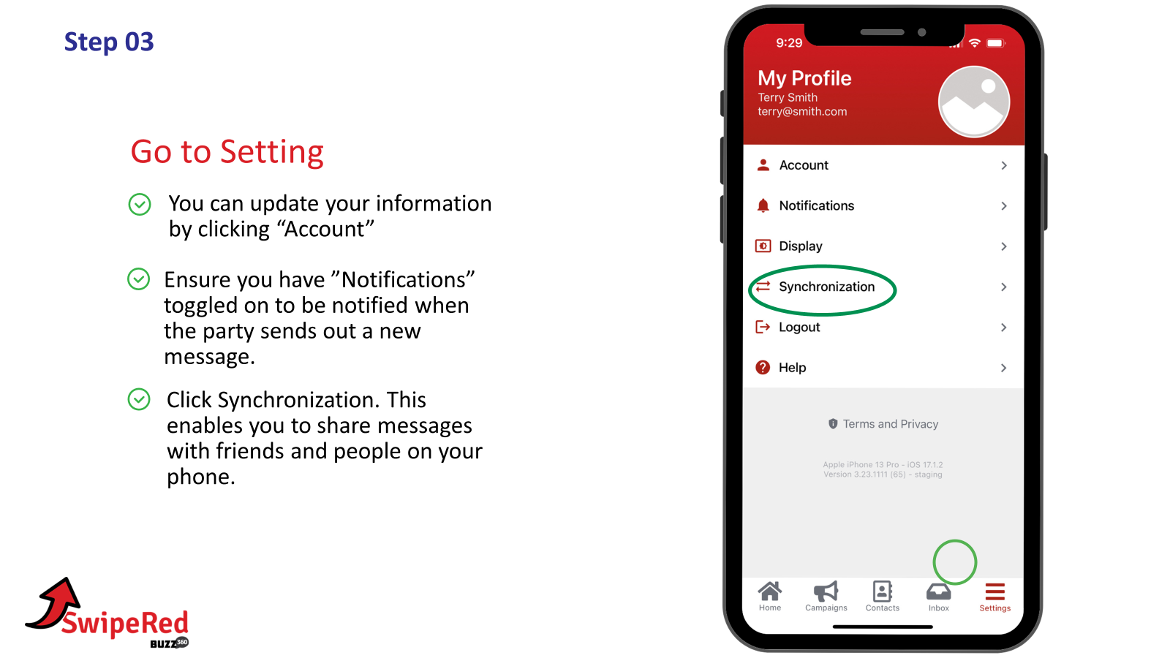
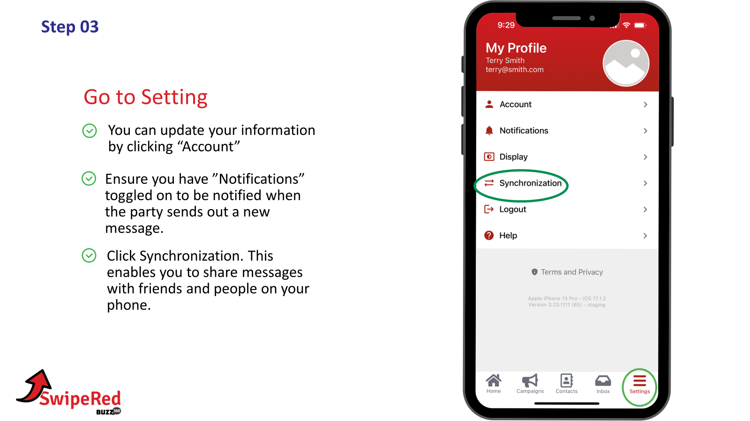

Slide 30
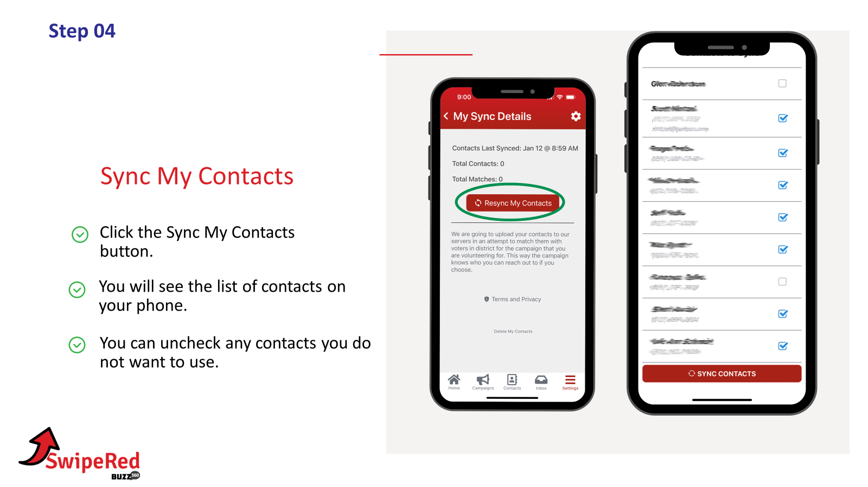
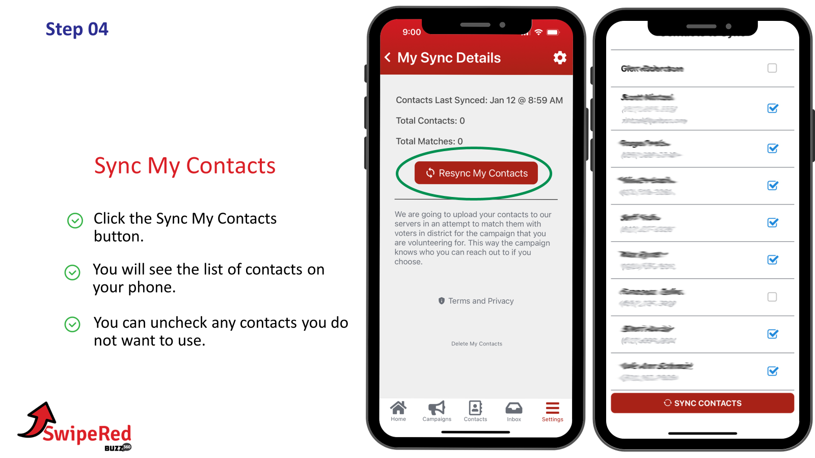

Slide 32
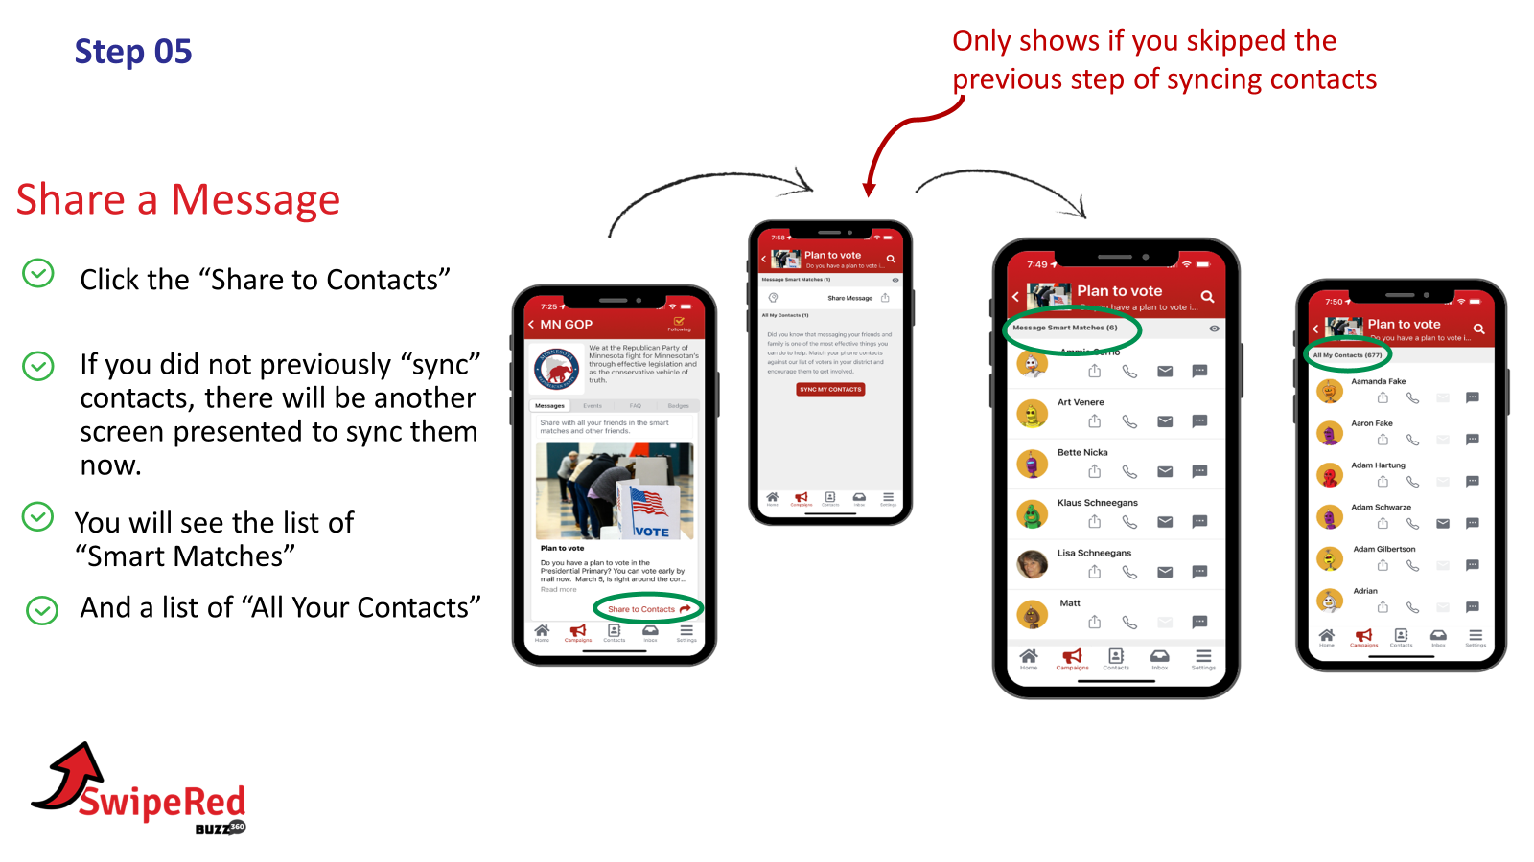

Slide 34
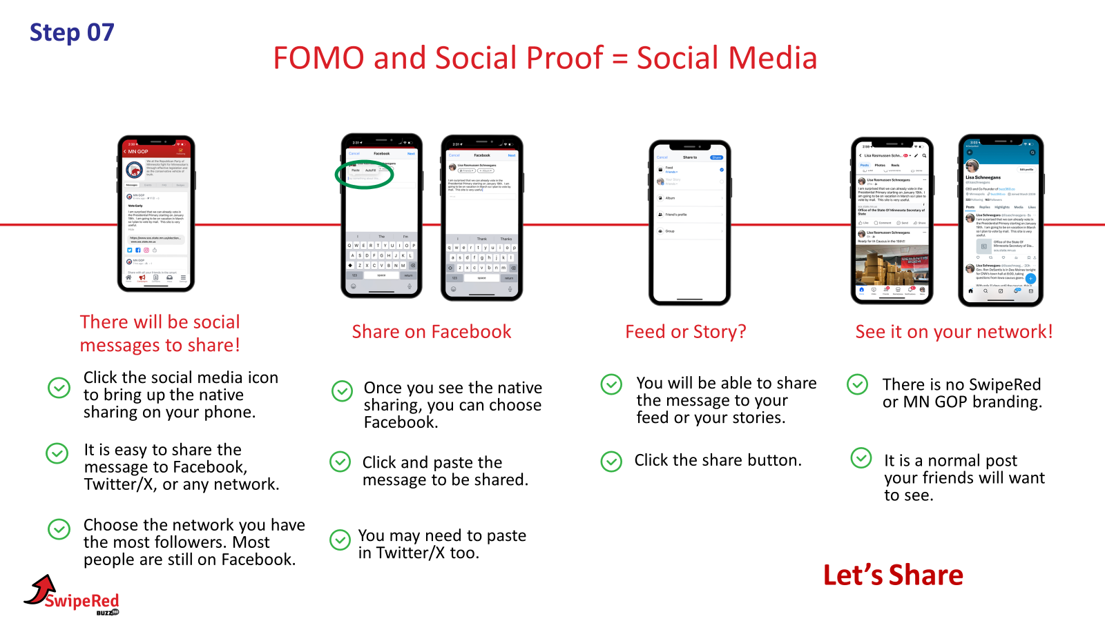

Slide 35
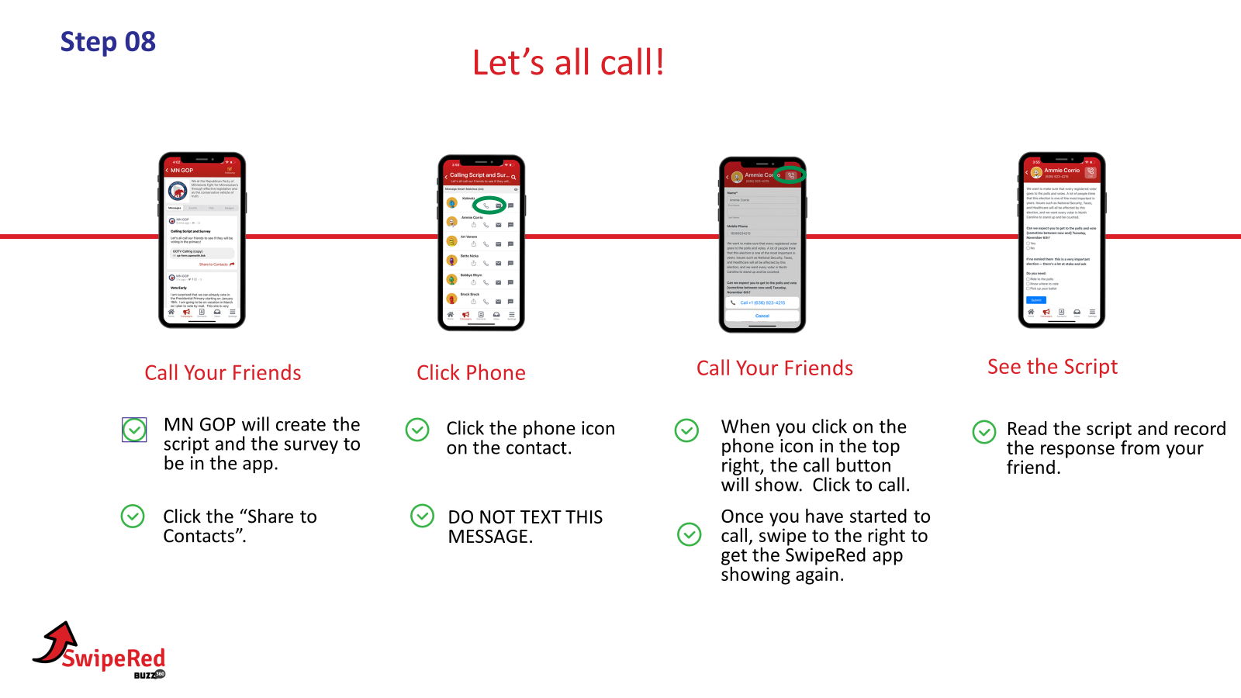
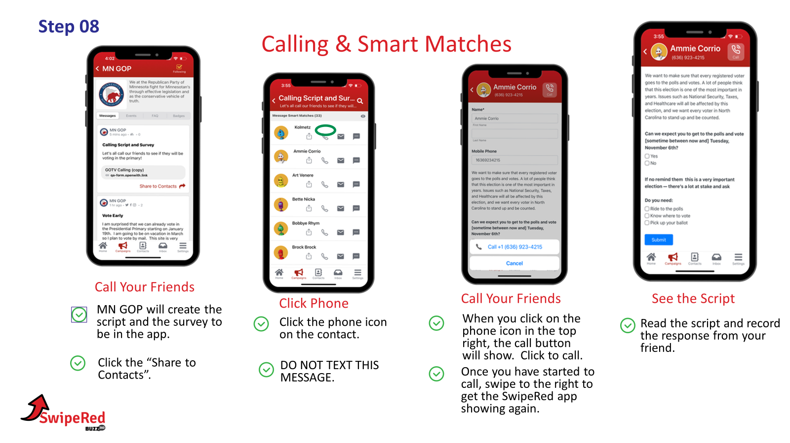

Slide 36
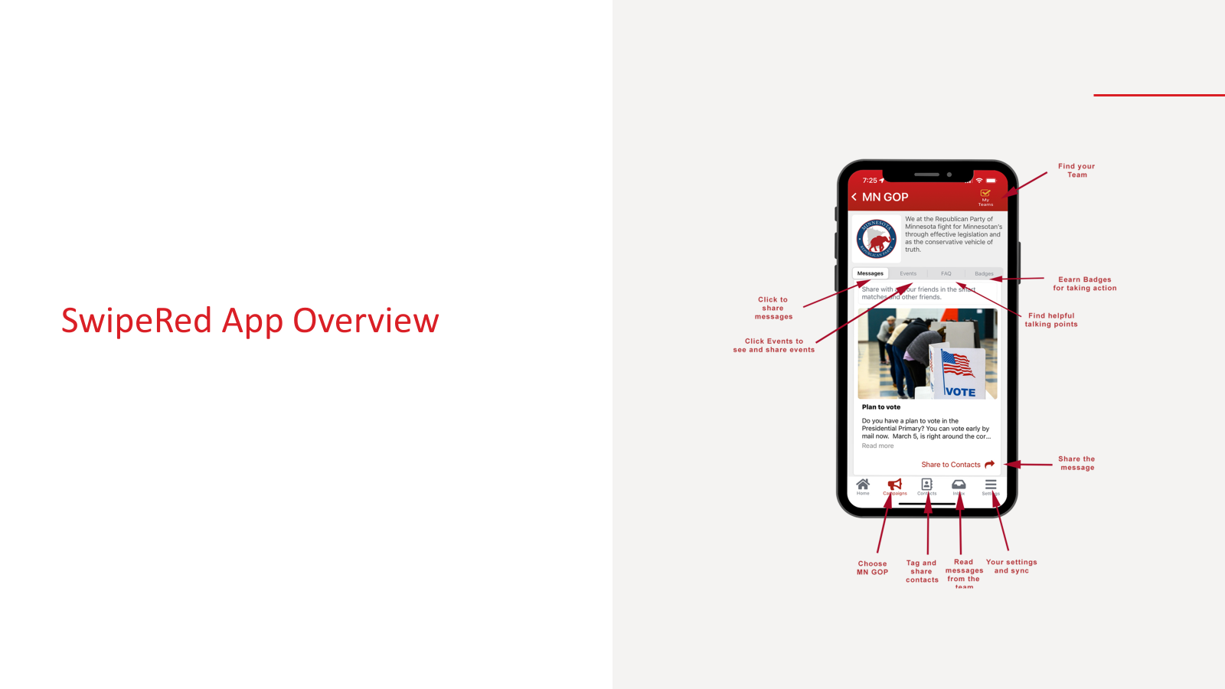
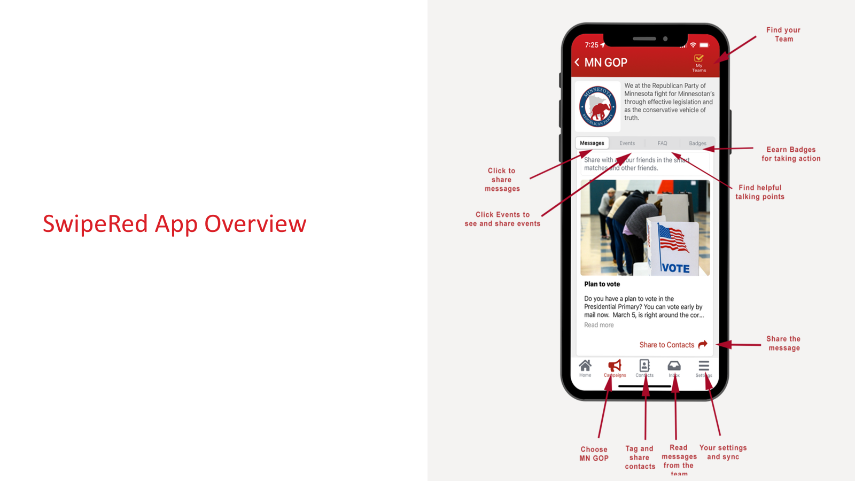

Slide 38
QUESTIONS?
Anna Mathews, Executive Director
AEM@MNGOP.com
Call/text (651) 968-6293
8 AM - 8 PM
Feedback: https://forms.gle/3hUpxE9KrgGG2YBAA

